Slide 1
Ontology-based Architecture
Ricardo Usbeck, Axel-Cyrille Ngonga, Saaedeh Shekarpour, Christoph Lange, et many al.
University Leipzig, University Bonn

Slide 2
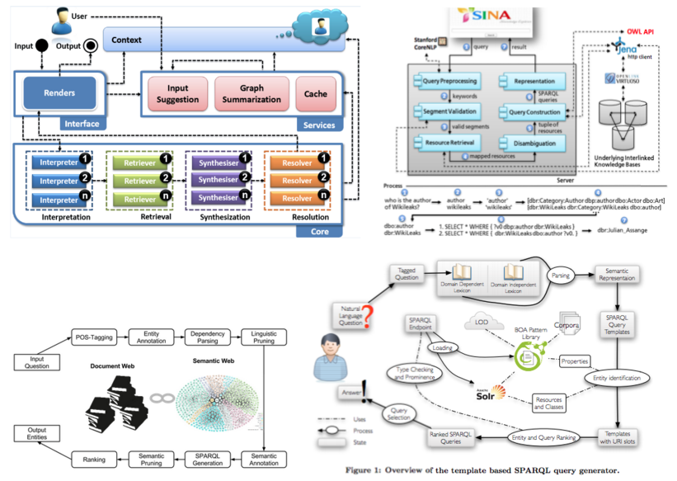
Motivation

Slide 3
Goal
Granularity (e.g., service for entity linking vs two services for entity recognition and disambiguation)
Interoperability, Reusability Ontology to describe input and output
Scalability (Load balancing via continuous life deployment)
Automatic building of pipelines (Using the ontology to deploy a set of fully-interoperable microservices)
(Automatic benchmarking) (Using high quality scientific benchmarks (QALD) various combined pipelines can be tested automatically and in parallel before deployment)

Slide 4
Solutions
QA Ontology
Identify common QA pipeline components
TBSL, SINA, HAWK, OpenQA, OKBQA, Unister paper,…
Components
Implement the microservice pipeline paradigm
Describe their input and output according to QA ontology
Communicating with message broker which are isolated from other components

Slide 5
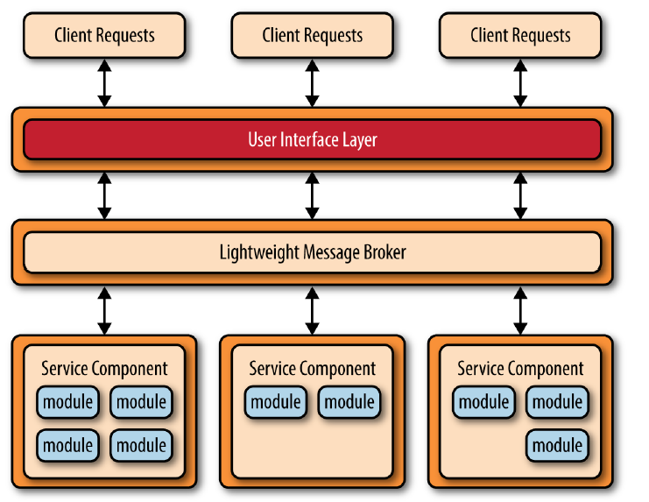
Architecture

Slide 6
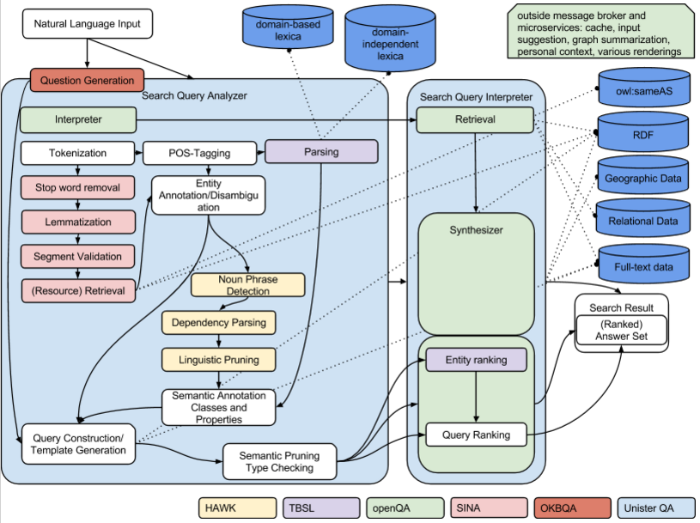
Combination of modules

Slide 7
Questions?
@akswgroup

