Slide 1
HAWK - Answering Boolean Hybrid Questions with HAWK
Ricardo Usbeck, Erik Körner, Axel-Cyrille Ngonga
University Leipzig

Slide 2
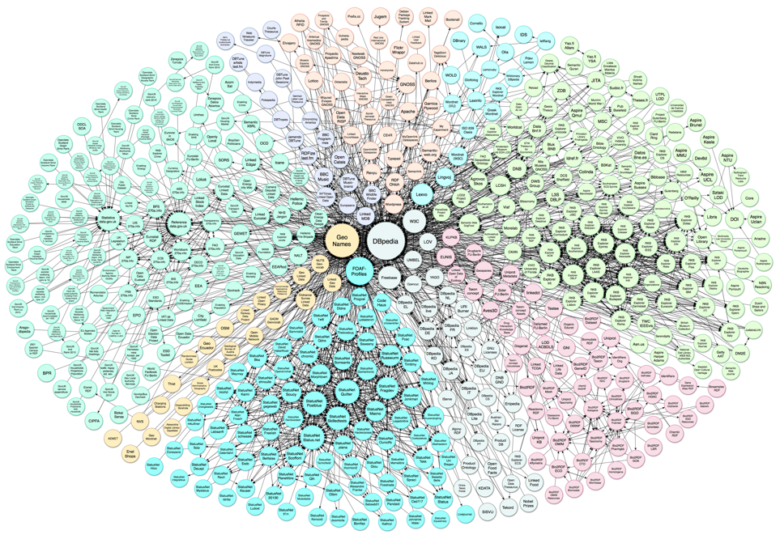
Motivation
Did Napoleon's first wife die in France?
Document Web
Linked Data Web
Notes:
The motivation behind our work was simple
document web:
petabytes of data , unstructured -> not machine readable
hard to extract semantics
Linked data web
highly structured
semantic information
easier to answer information need
however there is a INFORMATION MISMATCH
for example this information comes from the document web
the other information comes from the DBpedia
hence we aim to develop a framework to develop to combine both datasource.

Slide 3
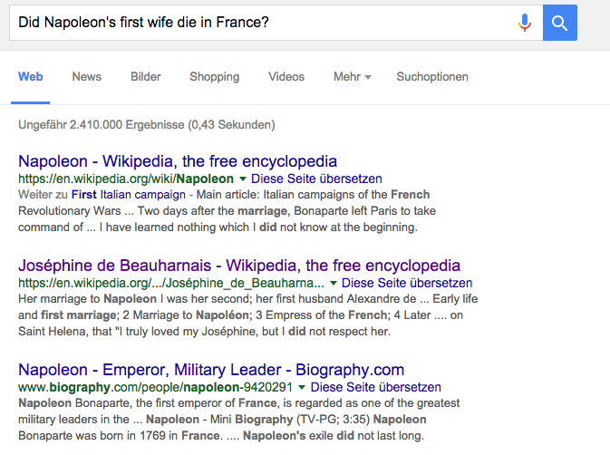
Motivation

Slide 4
Hawk - Hybrid Question Answering
Query: Did Napoleon's first wife die in France?
User Query
Hybrid Question Answering Framework
Yes!
Hybrid Answer
Notes:
Problem:
Combine full-text information retrieval (first wife of Napoleon) with Linked Data (death place of Joséphine de Beauharnais) !

Slide 5
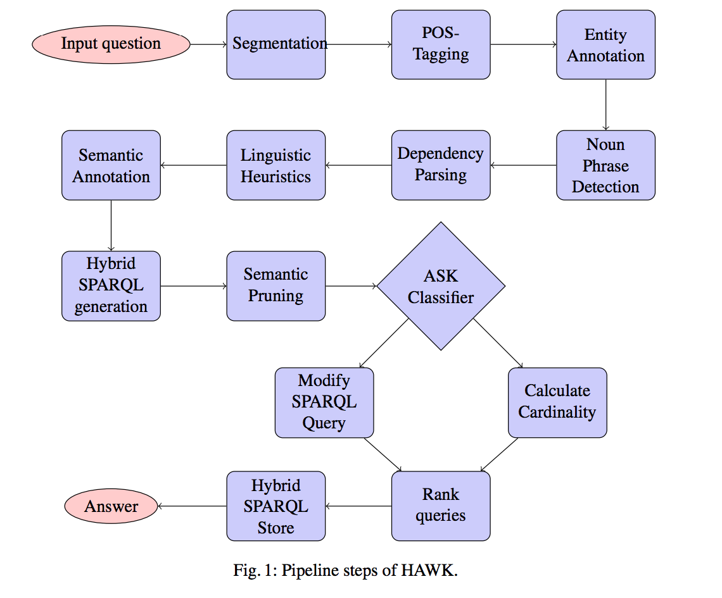
Hawk - Hybrid Question Answering
Notes:
This is the overall pipeline of the HAWK system

Slide 6
Hawk - Hybrid Question Answering
Notes:
Problem:
Combine full-text information retrieval (assassin of Martin Luther King) with Linked Data (birth place of James Earl Ray) !

Slide 7
Hawk -
POS Tagging / Segmentation
Query: Did Napoleon's first wife die in France?
Powered by the ClearNLP API
Segmentation based on WhiteSpace Tokenizer
Notes:
Problem:
Combine full-text information retrieval (assassin of Martin Luther King) with Linked Data (birth place of James Earl Ray) !

Slide 8
Hawk -
POS Tagging / Segmentation
VBD
ADJ
VB
NNP
NNP
NN
IN
.
Query: Did Napoleon's first wife die in France?
Powered by the ClearNLP API
Segmentation based on WhiteSpace Tokenizer
Notes:
Problem:
Combine full-text information retrieval (assassin of Martin Luther King) with Linked Data (birth place of James Earl Ray) !

Slide 9
Hawk - Hybrid Question Answering
Notes:
Problem:
Combine full-text information retrieval (assassin of Martin Luther King) with Linked Data (birth place of James Earl Ray) !

Slide 10
Hawk -
Entity Annotation
VBD
ADJ
VB
NNP
NNP
NN
IN
.
Query: Did Napoleon's first wife die in France?
Analysed the influence of 4 different annotation systems
Notes:
Problem:
Combine full-text information retrieval (assassin of Martin Luther King) with Linked Data (birth place of James Earl Ray) !

Slide 11
Hawk -
Entity Annotation
VBD
ADJ
VB
NNP
NNP
NN
IN
.
Query: Did Napoleon's first wife die in France?
dbr:Napoleon
dbr:France
Analysed the influence of 4 different annotation systems
Notes:
Problem:
Combine full-text information retrieval (assassin of Martin Luther King) with Linked Data (birth place of James Earl Ray) !

Slide 12
Hawk - Hybrid Question Answering
Notes:
Problem:
Combine full-text information retrieval (assassin of Martin Luther King) with Linked Data (birth place of James Earl Ray) !

Slide 13
Hawk -
Noun Phrase Detection
VBD
ADJ
VB
NNP
NNP
NN
IN
.
Query: Did Napoleon's first wife die in France?
dbr:Napoleon
dbr:France
Identify semantically meaningful word groups
POS tag sequence rules used
Notes:
Problem:
Combine full-text information retrieval (assassin of Martin Luther King) with Linked Data (birth place of James Earl Ray) !

Slide 14
Hawk -
Noun Phrase Detection
VBD
VB
NNP
NNP
ADJ/NN
IN
.
Query: Did Napoleon's first wife die in France?
dbr:Napoleon
Combined Noun
dbr:France
Identify semantically meaningful word groups
POS tag sequence rules used
Notes:
Problem:
Combine full-text information retrieval (assassin of Martin Luther King) with Linked Data (birth place of James Earl Ray) !

Slide 15
Hawk - Hybrid Question Answering
Notes:
Problem:
Combine full-text information retrieval (assassin of Martin Luther King) with Linked Data (birth place of James Earl Ray) !

Slide 16
Hawk -
Dependency Parsing
VBD
VB
NNP
NNP
ADJ/NN
IN
.
Query: Did Napoleon's first wife die in France?
dbr:Napoleon
Combined Noun
dbr:France
Parsing based on predicate-argument-trees
Notes:
Problem:
Combine full-text information retrieval (assassin of Martin Luther King) with Linked Data (birth place of James Earl Ray) !

Slide 17
Hawk -
Dependency Parsing
VBD
VB
NNP
NNP
ADJ/NN
IN
.
Query: Did Napoleon's first wife die in France?
dbr:Napoleon
Combined Noun
dbr:France
Parsing based on predicate-argument-trees
Notes:
Problem:
Combine full-text information retrieval (assassin of Martin Luther King) with Linked Data (birth place of James Earl Ray) !

Slide 18
Hawk - Hybrid Question Answering
Notes:
Problem:
Combine full-text information retrieval (assassin of Martin Luther King) with Linked Data (birth place of James Earl Ray) !

Slide 19
Hawk -
Linguistic Heuristics for pruning
VBD
VB
NNP
NNP
ADJ/NN
IN
.
Query: Did Napoleon's first wife die in France?
dbr:Napoleon
Combined Noun
dbr:France
Heuristic-based pruning of non-semantic words
Notes:
Problem:
Combine full-text information retrieval (assassin of Martin Luther King) with Linked Data (birth place of James Earl Ray) !

Slide 20
Hawk -
Linguistic Heuristics for pruning
VBD
VB
NNP
NNP
ADJ/NN
IN
.
Query: Did Napoleon's first wife die in France?
dbr:Napoleon
Combined Noun
dbr:France
Heuristic-based pruning of non-semantic words
Notes:
Problem:
Combine full-text information retrieval (assassin of Martin Luther King) with Linked Data (birth place of James Earl Ray) !

Slide 21
Hawk - Hybrid Question Answering
Notes:
Problem:
Combine full-text information retrieval (assassin of Martin Luther King) with Linked Data (birth place of James Earl Ray) !

Slide 22
Hawk -
Semantic Annotation
VBD
VB
NNP
NNP
ADJ/NN
IN
.
Query: Did Napoleon's first wife die in France?
dbr:Napoleon
Combined Noun
dbr:France
Dictionary-based surface form search
Ontology-based search for classes and properties
Notes:
Problem:
Combine full-text information retrieval (assassin of Martin Luther King) with Linked Data (birth place of James Earl Ray) !

Slide 23
Hawk -
Semantic Annotation
VBD
VB
NNP
NNP
ADJ/NN
IN
.
Query: Did Napoleon's first wife die in France?
dbr:Napoleon
Combined Noun
dbo:deathDate
dbo:deathPlace
dbr:France
Dictionary-based surface form search
Ontology-based search for classes and properties
Notes:
Problem:
Combine full-text information retrieval (assassin of Martin Luther King) with Linked Data (birth place of James Earl Ray) !

Slide 24
Hawk -
Semantic Annotation
VBD
VB
NNP
NNP
ADJ/NN
IN
.
Query: Did Napoleon's first wife die in France?
dbr:Napoleon
Full-text lookup
dbo:deathDate
dbo:deathPlace
dbr:France
Dictionary-based surface form search
Ontology-based search for classes and properties
Notes:
Problem:
Combine full-text information retrieval (assassin of Martin Luther King) with Linked Data (birth place of James Earl Ray) !

Slide 25
Hawk - Hybrid Question Answering
Notes:
Problem:
Combine full-text information retrieval (assassin of Martin Luther King) with Linked Data (birth place of James Earl Ray) !

Slide 26
Hawk -
Hybrid SPARQL Generation
VBD
VB
NNP
NNP
ADJ/NN
IN
.
Query: Did Napoleon's first wife die in France?
dbr:Napoleon
Full-text lookup
dbo:deathDate
dbo:deathPlace
dbr:France
N-fold cross-product of modules to create all possible basic graph patterns
Notes:
Problem:
Combine full-text information retrieval (assassin of Martin Luther King) with Linked Data (birth place of James Earl Ray) !

Slide 27
Hawk -
Hybrid SPARQL Generation
VBD
VB
NNP
NNP
ADJ/NN
IN
.
Query: Did Napoleon's first wife die in France?
dbr:Napoleon
‘first wife’
dbo:deathDate
dbo:deathPlace
dbr:France
N-fold cross-product of modules to create all possible basic graph patterns
Full-text lookup
Notes:
Problem:
Combine full-text information retrieval (assassin of Martin Luther King) with Linked Data (birth place of James Earl Ray) !

Slide 28
Hawk -
Hybrid SPARQL Generation
VBD
VB
NNP
NNP
ADJ/NN
IN
.
Query: Did Napoleon's first wife die in France?
‘first wife’
dbr:Napoleon
dbo:deathDate
dbo:deathPlace
dbr:France
SELECT ?proj
{?proj text:query 'first wife'.
?proj dbo:deathPlace dbr:France.
?proj ?pbridge dbr:Napoleon.}
SELECT ?proj
{?proj text:query 'first wife'.
?proj dbo:deathDate dbr:France.
?proj ?pbridge dbr:Napoleon.}
Notes:
Problem:
Combine full-text information retrieval (assassin of Martin Luther King) with Linked Data (birth place of James Earl Ray) !

Slide 29
Hawk -
Hybrid SPARQL Generation
VBD
VB
NNP
NNP
ADJ/NN
IN
.
Query: Did Napoleon's first wife die in France?
‘first wife’
dbr:Napoleon
dbo:deathDate
dbo:deathPlace
dbr:France
SELECT ?proj
{?proj text:query 'first wife'.
?proj dbo:deathPlace dbr:France.
?proj ?pbridge dbr:Napoleon.}
SELECT ?proj
{?proj text:query 'first wife'.
?proj dbo:deathDate dbr:France.
?proj ?pbridge dbr:Napoleon.}
Notes:
Problem:
Combine full-text information retrieval (assassin of Martin Luther King) with Linked Data (birth place of James Earl Ray) !

Slide 30
Hawk - Hybrid Question Answering
Notes:
Problem:
Combine full-text information retrieval (assassin of Martin Luther King) with Linked Data (birth place of James Earl Ray) !

Slide 31
Hawk -
Semantic Pruning
VBD
VB
NNP
NNP
ADJ/NN
IN
.
Query: Did Napoleon's first wife die in France?
‘first wife’
dbr:Napoleon
dbo:deathDate
dbo:deathPlace
dbr:France
SELECT ?proj
{?proj text:query 'first wife'.
?proj dbo:deathPlace dbr:France.
?proj ?pbridge dbr:Napoleon.}
SELECT ?proj
{?proj text:query 'first wife'.
?proj dbo:deathDate dbr:France.
?proj ?pbridge dbr:Napoleon.}
Notes:
Problem:
Combine full-text information retrieval (assassin of Martin Luther King) with Linked Data (birth place of James Earl Ray) !

Slide 32
Hawk -
Semantic Pruning
VBD
VB
NNP
NNP
ADJ/NN
IN
.
Query: Did Napoleon's first wife die in France?
‘first wife’
dbr:Napoleon
dbo:deathDate
dbo:deathPlace
dbr:France
SELECT ?proj
{?proj text:query 'first wife'.
?proj dbo:deathPlace dbr:France.
?proj ?pbridge dbr:Napoleon.}
SELECT ?proj
{?proj text:query 'first wife'.
?proj dbo:deathDate dbr:France.
?proj ?pbridge dbr:Napoleon.}
Notes:
Problem:
Combine full-text information retrieval (assassin of Martin Luther King) with Linked Data (birth place of James Earl Ray) !

Slide 33
Hawk -
Semantic Pruning
VBD
VB
NNP
NNP
ADJ/NN
IN
.
Query: Did Napoleon's first wife die in France?
‘first wife’
dbr:Napoleon
dbo:deathDate
dbo:deathPlace
dbr:France
SELECT ?proj
{?proj text:query 'first wife'.
?proj dbo:deathPlace dbr:France.
?proj ?pbridge dbr:Napoleon.}
Notes:
Problem:
Combine full-text information retrieval (assassin of Martin Luther King) with Linked Data (birth place of James Earl Ray) !

Slide 34
Hawk - Hybrid Question Answering
Notes:
Problem:
Combine full-text information retrieval (assassin of Martin Luther King) with Linked Data (birth place of James Earl Ray) !

Slide 35
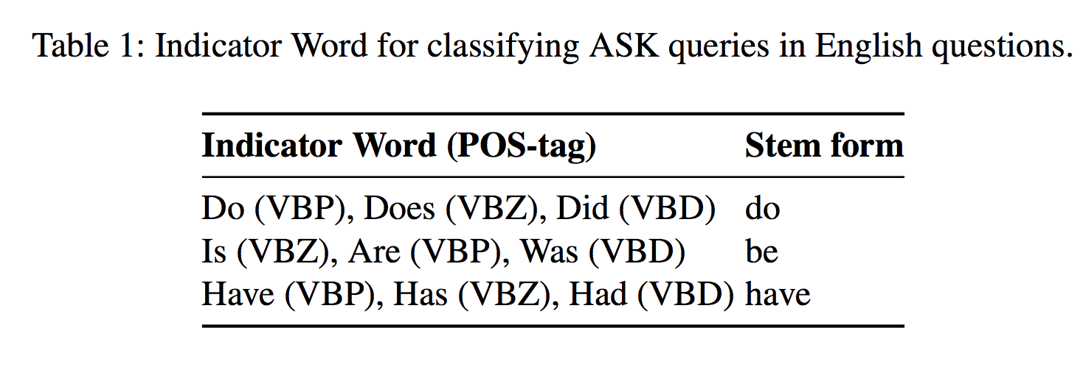
Hawk -
ASK Classification
Notes:
Problem:
Combine full-text information retrieval (assassin of Martin Luther King) with Linked Data (birth place of James Earl Ray) !

Slide 36
Hawk -
ASK Classification
VBD
VB
NNP
NNP
ADJ/NN
IN
.
Query: Did Napoleon's first wife die in France?
‘first wife’
dbr:Napoleon
dbo:deathDate
dbo:deathPlace
dbr:France
SELECT ?proj
{?proj text:query 'first wife'.
?proj dbo:deathPlace dbr:France.
?proj ?pbridge dbr:Napoleon.}
Notes:
Problem:
Combine full-text information retrieval (assassin of Martin Luther King) with Linked Data (birth place of James Earl Ray) !

Slide 37
Hawk -
ASK Classification
VBD
VB
NNP
NNP
ADJ/NN
IN
.
Query: Did Napoleon's first wife die in France?
‘first wife’
dbr:Napoleon
dbo:deathDate
dbo:deathPlace
dbr:France
ASK
{?proj text:query 'first wife'.
?proj dbo:deathPlace dbr:France.
?proj ?pbridge dbr:Napoleon.}
Notes:
Problem:
Combine full-text information retrieval (assassin of Martin Luther King) with Linked Data (birth place of James Earl Ray) !

Slide 38
Hawk - Hybrid Question Answering
Will not be covered in this talk.
Notes:
Problem:
Combine full-text information retrieval (assassin of Martin Luther King) with Linked Data (birth place of James Earl Ray) !

Slide 39
HAWK - Evaluation
Setup
QALD-5 only hybrid questions
Without Yago types, aggregations like FILTER
40 training, 10 test questions for hybrid QA
Plus boolean questions in general
⇒ 27 questions

Slide 40
HAWK - Evaluation
Question Type | F-measure | Global F-measure
Hybrid SELECT | 0.19 | 0.27
Hybrid ASK | 0.47 | 0.74
Hybrid SELECT+ASK | 0.24 | 0.35
Table 2: Results with and without the ASK extension of HAWK.

Slide 41
HAWK - Conclusion
Novel, modular, hybrid question answering system
Covers ASK questions
Challenges:
Training + benchmark datasets small
Answering other types of queries
Improve ranking mechanism
Extend the QA ecosystem

Slide 42
HAWK - Conclusion
Thank you! Questions?
@akswgroup
http://aksw.org/Projects/HAWK
http://github.org/aksw/hawk
Ricardo Usbeck
Axel Ngonga
Augustusplatz 10
Leipzig, Germany
http://aksw.org

Slide 43
HAWK - Evaluation
Entity Annotator Influence
=> Assume an optimal ranking
FOX = F-measure of 0.68
Optimal annotator = F-measure of 0.58
Union annotator = F-measure of 0.10

Slide 44
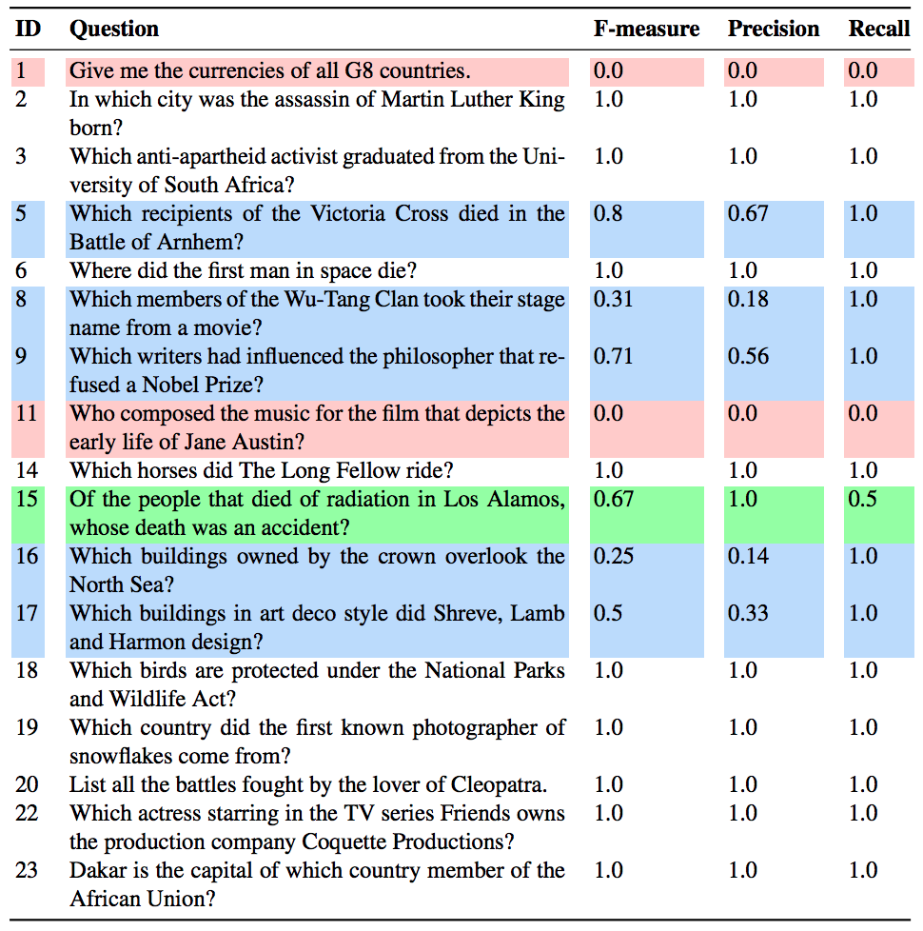
HAWK - Evaluation
Evaluation based on QALD 4
Assuming an optimal ranking

Slide 45
HAWK - Evaluation
Evaluation based on QALD 4
Assuming an optimal ranking
Precision = 0.70
Recall = 0.85
F-measure = 0.72

Slide 46
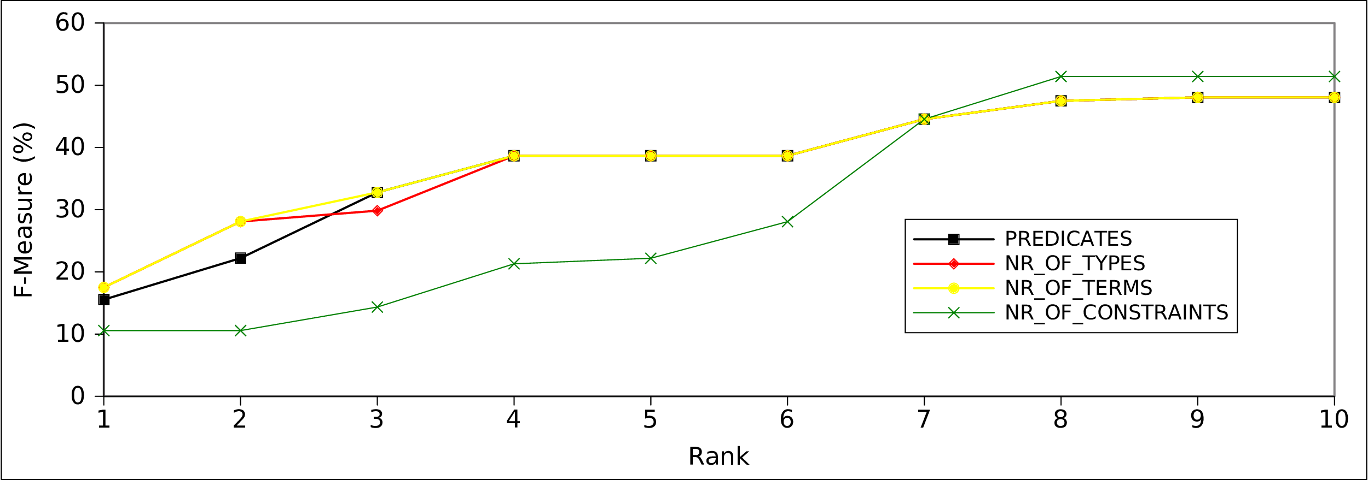
HAWK - Evaluation
Evaluation of Feature-based Ranking
Rank = Number of generated SPARQL queries

Slide 47
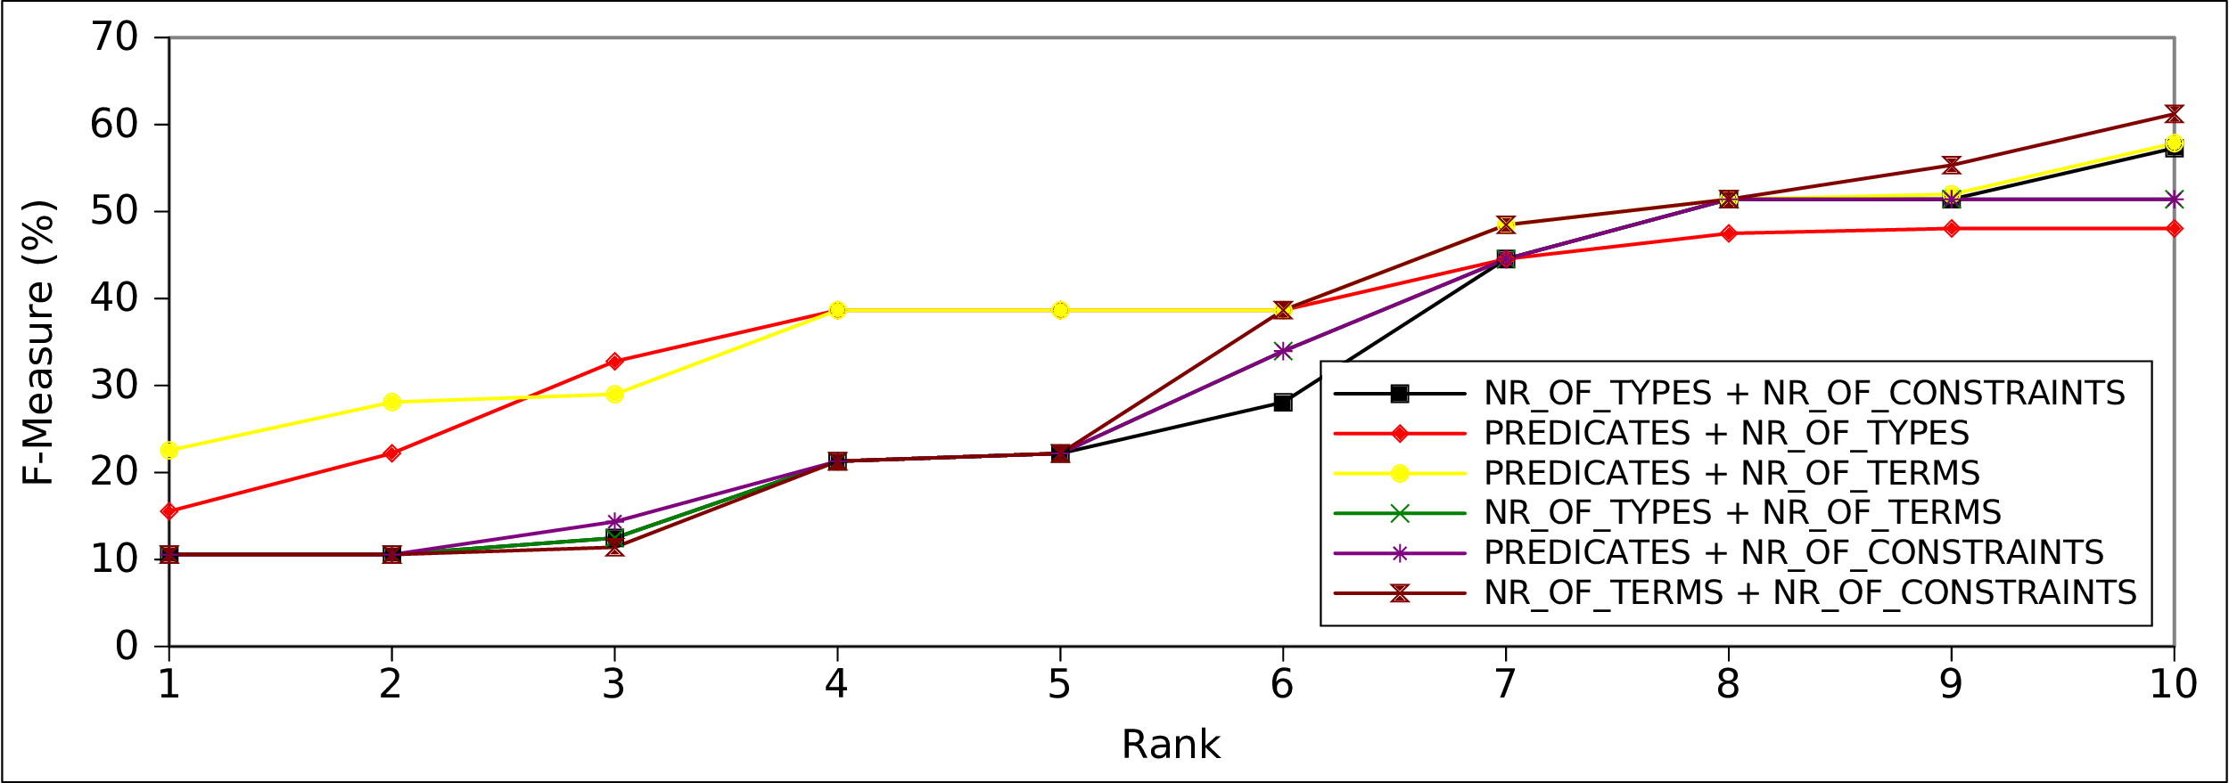
HAWK - Evaluation
Evaluation of Feature-based Ranking
Rank = Number of generated SPARQL queries

Slide 48
HAWK - Evaluation
Evaluation based on QALD 5
Assuming an optimal ranking
Train dataset:
Precision = 0.30
Recall = 0.30
F-measure = 0.30
Test dataset:
Only able to answer 1 Question correctly

